Slide 1
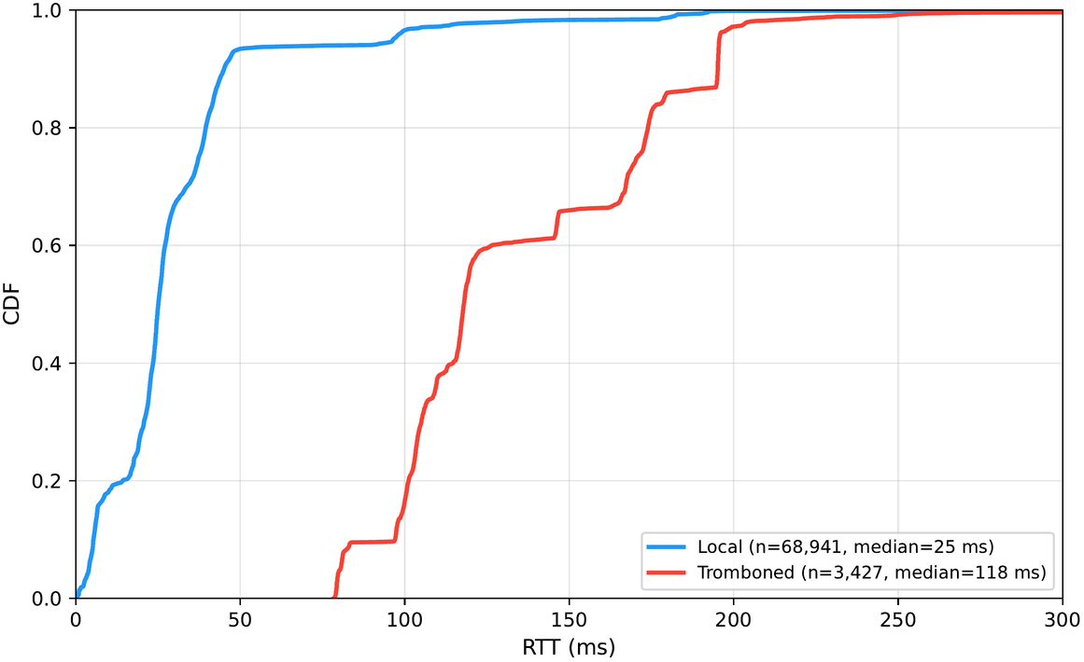
RQ3
Tromboning Cost:
Local traces to Pakistani-hosted sites run a median 25.1 ms; tromboned traces to the same class run 118.0 ms. This pools two different site populations, so it isn't a causal estimate. For the 4 sites reached both locally and via detour by different vantage points, avoiding the detour would cut RTT by 56%, a median saving of 75 ms, across 12 comparable pairs.
25.1 / 118.0 ms
local vs tromboned median RTT

